Slide 1
Airbnb Data Challenge
Understand data & sanity check
Key metrics to monitor guest-host matching success
Feature engineering & Model building
Segments doing well v.s. not well
Opportunities in increasing the number of successful bookings
Challenges of matching supply and demand
Additional research methods
Notes:
Title less technical

Slide 2
Understand Data
&
Sanity Check

Slide 3
Overview of Datasets
Contacts:
There are 27,887 unique inquiries with 11,588 bookings, 14 variables
Inquiries are made through 3 channels: Contact me, Book it, and Instant book
The inquiry time varies from 01/01/2016 to 06/30/2016, lead time of these inquiries ranges from 0 - 803 days
The check in dates varies from 01/01/2016 to 05/01/2018, and length of stay ranges from 1 - 365 days
Inquiries are made by either new bookers or past bookers for 1 - 16 guests
The total number of interactions between guest and host ranges from 1 - 410
Listings:
There 13038 unique listings with 4 variables
There are 3 room types for listings: Entire home/apt, private room and shared room
Listings are located in 68 neighborhoods
The number of reviews for listings ranges from 0 -268
Users:
There are 31457 users after dropping 68 duplicated ones, with 3 variables
Users are from 121 unique countries with profile length ranges from 0 - 1442

Slide 4
Sanity Check - Assumptions
Contacts
Inquiry/reply/accept/book timestamps:
ALL channels:
Inquiry time ≤ reply time ≤ accept time ≤ book time
All accepted inquiries must be replied
All booked inquiries must be accepted
Check in time ≤ check out time
Book it:
Accept time = book time
Instant book:
Inquiry time = reply time = accept time = book time
Guest size ≥ 1, total number of interactions ≥ 1, and message length ≥ 0
Listings:
Number of reviews ≥ 0
Users:
No duplicated users
Profile length ≥ 0

Slide 5
Sanity Check - Observations and Treatments
Contacts
Inquiry/reply/accept/book timestamps:
ALL channels:
452 inquiries where the inquiry time > reply time with lags between 1-70 seconds
Updated the reply time to be the same as inquiry time
Book it:
257 inquiries accepted but not booked,
Updated the book time to be the same as accept time
152 inquiries where booked but not accepted or book time ≠ accepted time
Updated the book time to be the same as accept time
Instant book:
40 inquiries where inquiry, reply, accept, and booking did not happen at the same hour (allowed the latency of an hour)
Filtered out these inquiries assuming they are erroneous records

Slide 6
Sanity Check - Observations and Treatments (Cont.)
Contacts:
Guest size:
4 inquiries where number of guests is 0:
Filtered out these inquiries assuming they are erroneous records
Listings:
Number of reviews:
41 listings with negative number of reviews:
Replaced with medium
Users:
Duplicates:
68 users with duplicate ids:
Remove from analysis

Slide 7
Merge Data
Guest information:
Merged guest information from ‘Users’ to ‘Contacts’, by ‘id_guest_anon’ in ‘Contacts’ and ‘id_user_anon’ in ‘Users’
Host information:
Merged host information from ‘Users’ to ‘Contacts’, by ‘id_host_anon’ in ‘Contacts’ and ‘id_user_anon’ in ‘Users’
Listing information:
Merged listing information from ‘Listings’ to ‘Contacts’, by ‘id_listing_anon’ in both datasets

Slide 8
Overview of Data After Cleaning
Before/After | Inquiries | Replied | Accepted | Booked
Contact me | 12,828/12,814 | 11,659/11,645 | 5,482/5,476 | 911/909
Book it | 8,366/8,352 | 7,503/7,492 | 4,240/4,237 | 3,983/3,980
Instant book | 6,693/6,682 | 6,693/6,682 | 6,693/6,682 | 6,693/6,682
Total | 27,887/27,848 | 25,855/25,819 | 16,415/16,395 | 11,587/11,571
27,848 valid inquiries were made by 22,540 unique guests
The inquiry time varies from 01/01/2016 to 06/30/2016
Inquiries were made for 12,812 unique listings of 8,956 unique hosts

Slide 9
Key metrics to monitor guest-host matching success

Slide 10
Key metrics to monitor guest-host matching success
Reply/acceptance rate/booking rate
Reply rate = # inquiries replied/# total inquiries
Acceptance rate = # inquiries accepted/# total inquiries
Booking rate = # inquiries booked/# total inquiries
These metrics help track the success rate of each steps of the booking funnel
Average interactions per inquiry
Avg interactions per inquiries = # total interactions / # total inquiries
By monitoring this metric, Airbnb can be proactively encourage interactions between hosts and guests when needed, since interaction the most important driver of acceptance and booking according to model results
Average number of reviews per inquiry
Review rate = # total reviews / # total listings
Based on model results, number of reviews positively impact booking success
By monitoring this metric, Airbnb can encourage guests to leave reviews for properties with few reviews and optimize resource allocation of encouraging reviews
Average inquiries per listing
# total inquiries/ # total listings
By monitoring this metric, Airbnb can capture the imbalance in supply and demand in certain region or neighborhood to guide guest or host recruiting plan

Slide 11
Feature engineering
&
Model building

Slide 12
Feature Engineering - Created interaction features
interactions_1-10
interactions_11-20
interactions_21-30
interactions_>30
reviews_0
reviews_1-10
reviews_11-20
reviews_21-30
reviews_>30
contact_me
lead_time_1-30d
lead_time_31-60d
lead_time_61-90d
lead_time_>90d
days_of_stay_1-5d
days_of_stay_6-10d
days_of_stay_11-15d
days_of_stay_>15d
guest_size_1
guest_size_2
guest_size_3-4
guest_size_5-6
guest_size_>6
rt_Entire_home/apt
rt_Private room
rt_Shared room
message_length_0-150
message_length_151-300
message_length_301-450
message_length_>450
past_booker
reply time
accept time
lead_time_1-30d*interactions_1-10
lead_time_1-30d*interactions_11-20
lead_time_1-30d*interactions_21-30
lead_time_1-30d*interactions_>30
lead_time_31-60d*interactions_1-10
lead_time_31-60d*interactions_11-20
lead_time_31-60d*interactions_21-30
lead_time_31-60d*interactions_>30
lead_time_61-90d*interactions_1-10
lead_time_61-90d*interactions_11-20
lead_time_61-90d*interactions_21-30
lead_time_61-90d*interactions_>30
lead_time_>90d*interactions_1-10
lead_time_>90d*interactions_11-20
lead_time_>90d*interactions_21-30
lead_time_>90d*interactions_>30

Slide 13
Feature Engineering - Created interaction features (Cont.)
days_of_stay_1-5d*interactions_1-10
days_of_stay_1-5d*interactions_11-20
days_of_stay_1-5d*interactions_21-30
days_of_stay_1-5d*interactions_>30
days_of_stay_6-10d*interactions_1-10
days_of_stay_6-10d*interactions_11-20
days_of_stay_6-10d*interactions_21-30
days_of_stay_6-10d*interactions_>30
days_of_stay_11-15d*interactions_1-10
days_of_stay_11-15d*interactions_11-20
days_of_stay_11-15d*interactions_21-30
days_of_stay_11-15d*interactions_>30
days_of_stay_>15d*interactions_1-10
days_of_stay_>15d*interactions_11-20
days_of_stay_>15d*interactions_21-30
days_of_stay_>15d*interactions_>30
days_of_stay_1-5d*interactions_1-10
days_of_stay_1-5d*interactions_11-20
days_of_stay_1-5d*interactions_21-30
days_of_stay_1-5d*interactions_>30
days_of_stay_6-10d*interactions_1-10
days_of_stay_6-10d*interactions_11-20
days_of_stay_6-10d*interactions_21-30
days_of_stay_6-10d*interactions_>30
days_of_stay_11-15d*interactions_1-10
days_of_stay_11-15d*interactions_11-20
days_of_stay_11-15d*interactions_21-30
days_of_stay_11-15d*interactions_>30
days_of_stay_>15d*interactions_1-10
days_of_stay_>15d*interactions_11-20
days_of_stay_>15d*interactions_21-30
days_of_stay_>15d*interactions_>30
message_length_0-150*interactions_1-10
message_length_0-150*interactions_11-20
message_length_0-150*interactions_21-30
message_length_0-150*interactions_>30
message_length_151-300*interactions_1-10
message_length_151-300*interactions_11-20
message_length_151-300*interactions_21-30
message_length_151-300*interactions_>30
message_length_301-450*interactions_1-10
message_length_301-450*interactions_11-20
message_length_301-450*interactions_21-30
message_length_301-450*interactions_>30
message_length_>450*interactions_1-10
message_length_>450*interactions_11-20
message_length_>450*interactions_21-30
message_length_>450*interactions_>30

Slide 14
Feature Engineering - Created interaction features (Cont.)
lead_time_1-30d*message_length_0-150
lead_time_1-30d*message_length_151-300
lead_time_1-30d*message_length_301-450
lead_time_1-30d*message_length_>450
lead_time_31-60d*message_length_0-150
lead_time_31-60d*message_length_151-300
lead_time_31-60d*message_length_301-450
lead_time_31-60d*message_length_>450
lead_time_61-90d*message_length_0-150
lead_time_61-90d*message_length_151-300
lead_time_61-90d*message_length_301-450
lead_time_61-90d*message_length_>450
lead_time_>90d*message_length_0-150
lead_time_>90d*message_length_151-300
lead_time_>90d*message_length_301-450
lead_time_>90d*message_length_>450
guest_size_1*rt_Entire_home/apt
guest_size_1*rt_Private room
guest_size_1*rt_Shared room
guest_size_2*rt_Entire_home/apt
guest_size_2*rt_Private room
guest_size_2*rt_Shared room
guest_size_3-4*rt_Entire_home/apt
guest_size_3-4*rt_Private room
guest_size_3-4*rt_Shared room
guest_size_5-6*rt_Entire_home/apt
guest_size_5-6*rt_Private room
guest_size_5-6*rt_Shared room
guest_size_>6*rt_Entire_home/apt
guest_size_>6*rt_Private room
guest_size_>6*rt_Shared room
contact_me*lead_time_1-30d
contact_me*lead_time_31-60d
contact_me*lead_time_61-90d
contact_me*lead_time_>90d
contact_me*days_of_stay_1-5d
contact_me*days_of_stay_6-10d
contact_me*days_of_stay_11-15d
contact_me*days_of_stay_>15d
contact_me*rt_Entire_home/apt
contact_me*rt_Private room
contact_me*rt_Shared room

Slide 15
Model Building
 | Reply | Acceptance | Booking
Sub dataset | All inquiries in Contact Me & Book It channel | All replied inquiries in Contact Me & Book It channel | All accepted inquiries in Contact Me channel
Features | Left out variables related to number of interactions (highly indicative) | Add independent variable reply time | Add independent variable accept time
Class weights | Add 10% more weight on not replied inquiries | / | Add 10% more weight on not booked inquiries

Slide 16
Model Building
Model type | Logistic regression
Collinearity | Regularized with ‘L2’ penalty
Feature selection | Removed features with coefficient of 0 when using ‘L1’ penalty
Cross validation | Used sklearn.model_selection.GridSearchCV to find the best hyperparameter value
Sampling method | Used stratified sampling in train/test split and cross validation
Evaluation metrics | Accuracy, precision, recall, AUC_ROC score

Slide 17
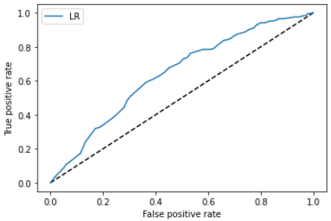
Model results - What impacts reply?
ROC curve for reply
Optimized parameter: Penalty = ‘L2’, C = 0.01
Weighted average class Accuracy 88%, Precision 92%, Recall 94%
Confusion Matrix
 | Predicted Reply | Predicted Not Reply
Replied | 1959 | 140
Not Replied | 179 | 134
AUC score 0.64

Slide 18
Model results - What impacts reply?
Significant Features | Coefficient
reviews_>30 | 0.508
reviews_21-30 | 0.2831
message_length_151-300*lead_time_31-60d | 0.1644
Private room*guest_size_3-4 | 0.1231
reviews_0 | -0.8127
message_length_0-150 | -0.1788
contact_me*past_booker | -0.1649
lead_time_>90d | -0.1183
Having more than 20 reviews (ideally 30) increases reply rate, and having 0 reviews significantly decreases it
For inquiries with lead time between 31- 60 days, message length of 151- 300 characters are more likely to be replied
For inquiries with guest size of 3 or 4, choosing private room would be increase reply rate
Hosts are less likely to respond to first messages with less than 150 characters
Using Contact Me channel reduces the reply rate of past bookers’ inquiries
Inquiries made too far ahead of check-in are less likely to be replied

Slide 19
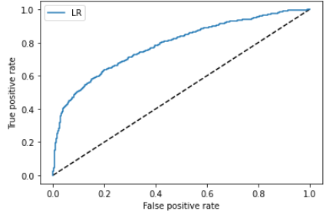
Model results - What impacts acceptance?
Optimized parameter: Penalty = ‘L2’, C = 0.048
Weighted average class Accuracy 77%, Precision 80%, Recall 45%
Confusion Matrix
ROC curve for acceptance
 | Predicted Accept | Predicted Not Accept
Accepted | 1294 | 85
Not Accepted | 411 | 330
AUC score 0.79

Slide 20
Model results - What impacts Acceptance?
Having more than 20 interactions increases the chance of acceptance and having less than 10 interactions decrease it
Inquiries for listings with more reviews are more likely to be accepted
For inquiries made more than 90 days ahead, using Contact Me channel increase its chance to be accepted
For inquiries made more than 90 days ahead, having less than 10 interactions decreases their chance to be accepted
For inquiries with duration between 1- 5 days, having less than 10 interactions decreases their chance to be accepted
Significant Features | Coefficient
interactions_>30 | 0.5806
interactions_21-30 | 0.5122
reviews_>30 | 0.471
contact_me*lead_time_>90d | 0.4061
interactions_1-10 | -1.1965
reviews_0 | -0.8542
lead_time_>90d*interactions_1-10 | -0.6393
days_of_stay_1-5d*interactions_1-10 | -0.5807

Slide 21
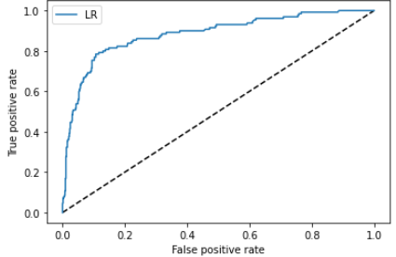
Model results - What impacts booking?
ROC curve for booking
Optimized parameter: Penalty = ‘L2’, C = 0.093
Weighted average class Accuracy 89%, Precision 71%, Recall 54%
Confusion Matrix
 | Predicted Book | Predicted Not Book
Book | 617 | 29
Not Booked | 60 | 70
AUC score 0.88

Slide 22
Model results - What impacts Booking?
Significant Features | Coefficient
interactions_>30 | 0.9256
interactions_21-30 | 0.6503
past_booker | 0.5745
message_length_151-300*interactions_>30 | 0.4228
interactions_1-10 | -1.7255
lead_time_>90d*interactions_1-10 | -0.6576
message_length_0-150*interactions_1-10 | -0.5106
days_of_stay_>15d | -0.5073
Having more than 20 interactions increases the chance of booking and having less than 10 interactions decrease it
Paster bookers are more willing to book make the booking when their inquiries is accepted
When first message length is between 151 - 300 characters, having more than 30 interactions increases the inquiry’s chance to be booked
For inquiries made more than 90 days ahead, having less than 10 interactions decreases their chance to be accepted
When first message length is between 151 - 300 characters, having more than 30 interactions increases the inquiry’s chance to be booked
Inquiries for stays over 15 days are less likely to be booked

Slide 23
Opportunities in increasing the number of successful bookings

Slide 24
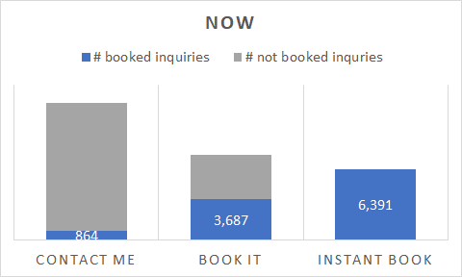
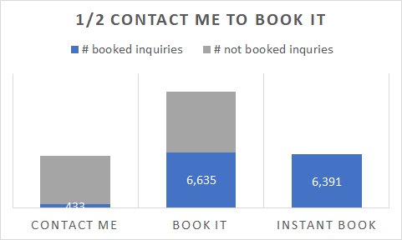
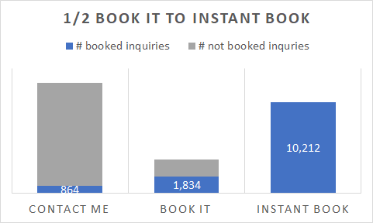
Findings and Opportunities - Channels
The majority (47%) of the inquiries are made in Contact Me channel, but only 7% of them turned into successful bookings, compare to 29% in Book It with success rate of 48% and 24% in Instant Book with success rate of 100%
If Airbnb can shift ½ of the inquiries in Contact Me channel to Book It, we could gain 2517 additional bookings, bringing up the platform’s overall success rate from 41% to 60%
If Airbnb can shift ½ of the inquiries in Book It channel to Instant Book, we could gain 1998 additional bookings, bringing up the platform’s overall success rate from 41% to 49%

Slide 25
Recommendations - Channels
Use Instant Book channel
Encourage guests to use Instant Book channel:
Educate past bookers who used Book It about the benefit and convenience of switching to Instant Book
Encourage hosts to opt-in for Instant Book channel
Give credit to hosts opted-in for Instant Book channel, streamline the opt-it process
Use Book It channel
If Instant Book is not available, encourage guests to use Book It channel instead of Contact Me
Prompt users that their inquiries are 47% more likely to be accepted in Book It channel

Slide 26
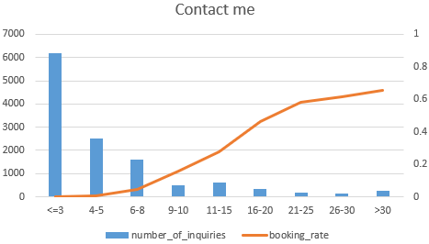
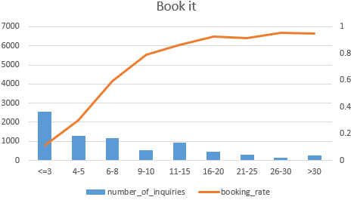
Findings and Opportunities - Interactions
50% of the inquiries (6,195) in Contact Me channel had no more than 3 interactions, with booking rate less than 0.1%, 33% of the inquiries (2,546) in Book It channel had no more than 3 interactions, with booking rate of 12%
If the inquiries in Contact Me channel can have more than 15 interactions, success rate would climb up to 47%, and when interaction exceeds 25, booking rate could reach 62%
If the inquiries in Book It channel can have more than 5 interactions, success rate would climb up to 60%, and when interaction exceeds 10, booking rate could reach 87%. However, booking rate stops climbing after 25 interactions

Slide 27
Recommendations - Interactions
For both Contact Me and Book It channels
Remind guests and hosts to reply to each other’s message
For Contact Me channel
Suggest to guests and hosts that bookings are usually associated with at least 15 interactions and preferably 25
For Book It channel
Encourage interactions between guests and hosts when they have less than 10 interactions
No need to worry about interactions then the number exceeds 25

Slide 28
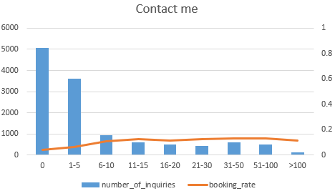
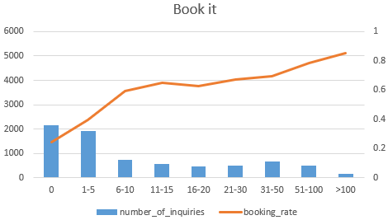
Findings and Opportunities - Reviews
70% inquiries made in Contact Me channel were for listings with no more than 5 reviews with booking rate less than 7%, and 53% inquiries made in Book It were for listings with no more than 5 reviews with booking rate less than 40%
For Contact Me channel:
Having at least 11 reviews drives booking rate up to 15%
For Book It channel:
Having at least 11 reviews drives booking rate up to 65%
Having more than 50 reviews drives booking rate up to 78% and reaches 85% when review > 100

Slide 29
Recommendations - Reviews
For both Contact Me and Book It channels
Recommend listings with at least 11 reviews
For Book It channel
Recommend listings with over 50 reviews if there is any
For all guests
Encourage them to leave a review after completing their trips
For all hosts
Encourage them to ask for a review when they interact with the guests
For property with few reviews
If the listing is new, promote the listings so that it could have chance to get more reviews
If the property already accommodated many guests, conduct surveys regarding the lack of reviews

Slide 30
Finding and Opportunities - User stages
58% of the users are new users, but 55% of them chose Contact Me channel with booking rate of only 6%
[# of inquiries] reply/acceptance/booking rate* | Contact Me | Book It | Instant Book
New Booker | [8,793] 91%/42%/6% | [4,296] 89%/46%/46% | [2,802] 100%/100%/100%
Past Booker | [4,005] 90%/42%/9% | [4,050] 90%/50%/50% | [3,881] 100%/100%/100%
For new users:
Only 15% of the accepted inquiries in Contact Me channel are booked by guests
83% of the booked inquiries in Contact Me channel had over 10 interactions
For past bookers:
Only 22% of the accepted inquiries in Contact Me channel are booked by guests
90% of the booked inquiries are in either Book It or Contact Me channel

Slide 31
Recommendations - User stages
For both new users and past bookers
Encourage guests to use Book It or Instant Book channel instead of Contact Me
For new users
Encourage hosts to interact more often with the guests for at least 10 times
For past bookers
Find out why the booking rate is low for accepted inquiries

Slide 32
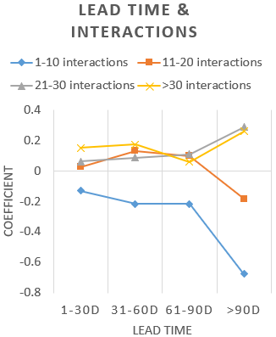
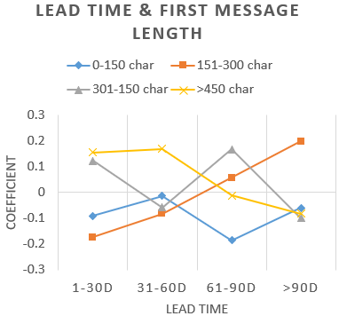
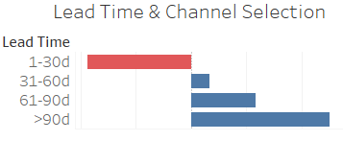

Findings and Opportunities - Long lead time
Model results
35% of the inquiries had lead time > 90 days, with booking rate less than 20%
For inquiries with long lead time:
Having more than 20 interactions increases the booking rate
Making inquiries in Contact Me channel increases the booking rate
Sending first messages of 151-300 characters increases the booking rate

Slide 33
Recommendations - Long lead time
If guests make inquiries more than 90 days ahead of check-in:
Encourage guests to use Contact Me channel so that hosts can have the chance to interact more often with the guest (at least 20 times)
Encourage guest to send first message between 151- 300 characters, providing more information as to the reason for making an inquiry so far ahead
If the inquiry got rejected, remind the users to make a new one later

Slide 34
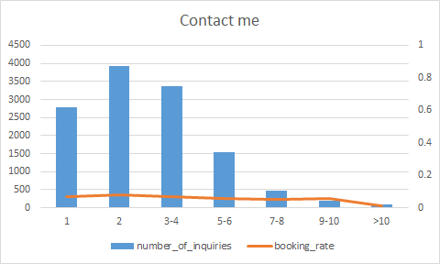
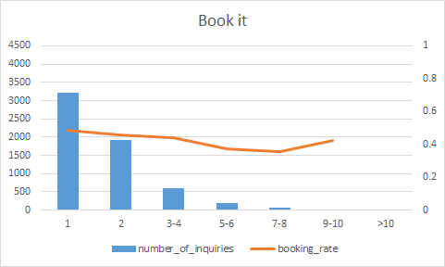
Findings and Opportunities - Guest sizes
57% of the inquiries are for under 2 guests, with booking rate less than 9% in Contact Me channel but over 46% in Book It channel
According to model results
When guest size = 1, inquiries for a shared room are most likely to be accepted
When guest size = 2, inquiries for an entire_home/apt are likely to be rejected
When guest size >= 3, inquiries for entire home/apt are more likely to be accepted

Slide 35
Recommendations - Guest sizes
For guests under 2 people
Recommend user to make inquiries in Book It channel instead of Contact Me
If the user still chooses Contact Me channel:
If guest size = 1, recommend shared rooms to the user
If guest size = 2, recommend private rooms to the user
For guests over 3 people:
Encourage guests to use Book It channel or Instant Book channel instead of Contact Me
If the user still chooses Contact Me channel
Recommend entire room/apt to the user

Slide 36
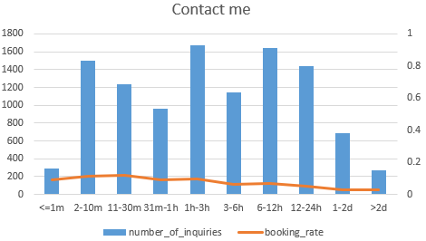
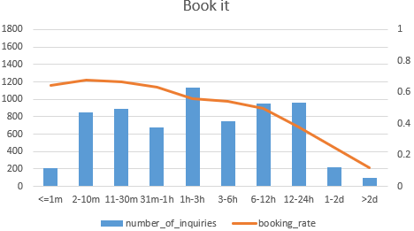
Findings and Opportunities - Reply time
For Contact Me channel, 1+ hour reply time drags success rate below 10% and reply time 6+ hour drags success rate below 6%
For Book It channel, 1+ hour reply time drags success rate below 60% and reply time 6+ hour drags success rate below 50%
If Airbnb can make half of the 1+ hour reply in Contact Me channel to <1 hour, we could gain 408 additional bookings, bringing up channel’s overall success rate from 7% to 10%
If Airbnb can make half of the 1+ hour reply in Book It channel to <1 hour, we could gain 1232 additional bookings, bringing up the platform’s overall success rate of from 48% to 64%

Slide 37
Recommendations - Reply time
For all hosts
Inform them that quick reply significantly increases booking rate according to historical data
Encourage them to respond to guests’ messages within 6 hours and preferably within 1 hour
For all guests
Encourage them to use Book It or Instant Book channel instead of Contact Me
Encourage them to include questions they want hosts to answer in their first inquiring message

Slide 38
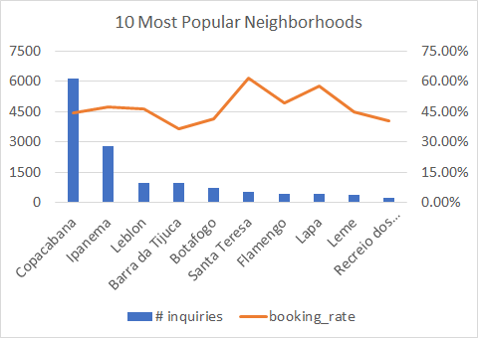
Findings and Opportunities - Neighborhood
For the most popular neighborhoods: Copacabana and Ipanema
6158 and 2766 inquiries were made for listings in the two neighborhood with booking rates 45% and 47%
Instant Book usages are 26% and 29% in the two neighborhood
For the most successful neighborhoods: Santa Teresa and Lapa
546 and 406 inquiries were made for listings in the two neighborhood with booking rates 61% and 58%
Instant Book usages are 41% and 44% in the two neighborhood
For the worst performance neighborhood: Barra da Tijuca
960 inquiries were made for listings in the neighborhood with booking rate only 37%
Instant Book usage of 20% and Contact Me usage of 53%

Slide 39
Recommendations - Neighborhood
For the most popular neighborhoods: Copacabana and Ipanema
Encourage guests to use Instant Book channel when making inquiries in the two neighborhoods
Encourage hosts to opt-in for Instant Book channel
For the most successful neighborhoods: Santa Teresa and Lapa
Recruit more hosts and properties to the platform
Promote listings in the two neighborhood in the user searching results
For the the worst performance neighborhood: Barra da Tijuca
Conduct deeper researches to find out the root cause of high usage on Contact Me channel
Recommend similar listings in neighborhoods near the area to the users

Slide 40
Segments doing well v.s. not well

Slide 41
Segments doing well v.s. not well
Segments doing well:
Instant Book channel:
Success rate 100%
Average # interactions per inquiries 11
Inquiries with 15+ interactions:
Success rate 75%
Listing with 30+ reviews:
Success rate 73%
Average # interactions per inquiries 9
Past Booker:
Success rate 53%
Average # interactions per inquiries 9
Not well:
Contact Me channel:
Success rate 7%
Average # interactions per inquiries 6
Inquiries with <3 interactions:
Success rate 12%
Listing with 0 reviews:
Success rate 28%
Average # interactions per inquiries 6
New Booker:
Success rate 33%
Average # interactions per inquiries 8

Slide 42
Challenges of matching supply and demand

Slide 43
Challenges of matching supply and demand
Challenges on the demand side
Different income level of guests affects their affordable price range
Different traveling purposes of guests affects their searching criteria and listing selection
Limitations on check-in and check-out time and process
Challenges on the supply side
Hosts might not be able to set the most efficient price for their listings
Hosts’ preference and/or concerns over characteristics of guests’
Property maintenance and insurances
Local regulations on short-term and long-term leasing

Slide 44
Additional research methods

Slide 45
Additional research methods
Conduct surveys to develop richer personas of bookers and hosts and to evaluate their user experience
Carry out A/B testing to find the most efficient prices for different booker segments and types of properties in different seasons and regions

